Slide 1
MANDATED REPORTER
Supporting, Protecting and Safeguarding Children through Distance Learning

Slide 2
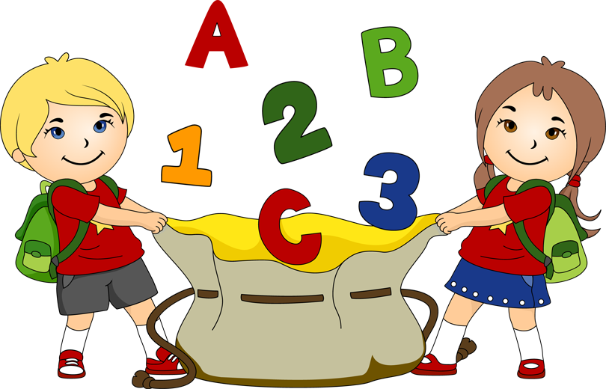
MRP & Distance Learning
Guide school personnel with innovative ways by which you can help to keep children safe by recognizing and reporting signs of suspected child abuse and neglect through distance learning.
Provide school personnel with resources appropriate for parents, families, and caregivers that will help them in supporting their children through the challenges of distance learning.

Slide 3


CHILD & FAMILY SERVICES
Vision Statement
Every child will live in a safe, stable, permanent home, nurtured by healthy families and strong communities.

Slide 4



MANDATED REPORTING TIMELINES
During the capacity of your job you are required by law to report any Suspected Child Abuse to Child Welfare or law enforcement immediately or as soon as possible. Send a written report within 36 hours.
Failure to report is a misdemeanor punishable by up to 6 months in jail and or a $1000.00 fine.

Slide 5

What do I report?

Slide 6

Physical Abuse
Sexual Abuse
Neglect (Severe & General)
No Caretaker
Caretaker Incapacity
Emotional Abuse

Slide 7



If you observe,
have knowledge of,
are told about,
or reasonably suspect abuse,
you must report it!

Slide 8


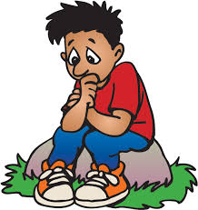

Stressors Associated with Pandemics
Uncertainty, confusion and fear
Acute and/or chronic health threats
Food, supply and medical shortages
Severe disruption of routines
Separation from family, friends and co-workers
Social isolation (Grandparents, extended kin)
School closure
* (Taylor, 2019)*Quality Improvements Center for Workforce Development and Children’s Bureau
Notes:
Pandemics are marked by uncertainty, confusion and a sense of urgency (WHO 2005) which is exacerbated by 24/7 news cycle, social media- with a constant bombardment of information (some of which is contradictory).
In early stages there is uncertainty about odds and seriousness of getting infected.
This uncertainty can persist as it is difficult to know when a pandemic has ended.
Pandemics often come in waves.
Health threats to self and loved ones; caring for ill loved ones
The inability to bury, memorialize and honor the dead (whether it is due to the pandemic or another cause) due to high costs, shortage of coffins, graveyard space, and the inability to congregate
Shortages of food, supplies and medicines
Malnutrition if parent is ill and can’t shop for and cook nutritious meals or if money is low
Severe disruption of routines

Slide 9

Stressors Associated with Pandemics
Stresses on some local health care system
Wage loss/Unemployment
Erosion of social fabric including exploitation, crime and discrimination
Economic break down leading to a recession or a depression
Malnutrition
Inability to bury, memorialize and honor the dead (whether it is due to the pandemic or another cause)
These stressors can lead, especially in trauma-affected persons, to reactions: fear, indifference, fatalism, repetitive checking for information, the need for reassurance, and mood disorders
Notes:
Separation from family, friends and co-workers due to quarantine and social distancing
Social isolation due to quarantine and social distancing
School closure (Schultz et al, 2008)
Wage loss- in fact, financial stress on families and economic stress in the larger society is sometimes greater than the losses brought about by contracting the illness, especially for those that are already poor
If the social fabric erodes there may be additional stressors such as exploitation by corporations (e.g. jacking up prices of rare items), or acts of crime by members of the community.
Stresses on the health care system can overwhelm it (when health care providers become ill, when supplies and equipment such as masks, gloves, medicines, ventilators are low, when there are not enough beds, etc.)
The economy can break down leading to a recession or a depression
Elevations in unemployment, cuts in wages
Corporations and businesses may fail with out bailouts from the government
The National Academy of Medicine in 2016 estimated that the next pandemic would cost 6 trillion in losses… which may be a fraction of what Covid-19 will cost.
Disease related stigma has grave consequences-
1) it is stressful in and of itself
2) people may not seek healthcare for fear of discrimination can exacerbate distrust in health
institutions
3) can lead to social marginalization- poverty, neglect and isolation that furthers the spread of the
disease
4) may exacerbate fear and anxiety and cause avoidance of parts of town, certain businesses, etc. Often
why pandemics named the way they are.

Slide 10

Contextual Thoughts
Remote Learning/Teaching engagements are opportunities, regardless of the current pandemic, to engage, support and assist caregivers and parents in keeping their children safe.
Parents are likely stressed in unique ways. Empathy, mindfulness and empowerment are more critical than ever.
Most people benefit from human connection and engagement as much as from any professional Mental Health intervention. Reducing isolation is the primary goal.
Notes:
Most people benefit from human connection and engagement as much as from any professional Mental Health intervention. Reducing isolation is the primary goal.

Slide 11

Engaging in Conversations with your Students
Build in time to check-in on your students’ overall health and well-being. Try to avoid yes and no questions.
Be mindful of who may be listening in the background.
If possible, use synchronous digital technology to connect with students visually at least weekly.
Keep a log of the dates and times you speak to your students and document any behavior or comments that raise a red flag.
Notes:
Educators are finding new ways to check-in with their students through distance learning. While a primary purpose of distance learning is to deliver instruction, it is critical that educators also build in time to check-in on their students’ overall health and well-being.

Slide 12

Deepening Engagement
Mirror the student’s pace and adjust to meet his/her pace and cadence.
Listening is powerful…
“I am hearing you…”
Notes:
Remember to keep your tone, demeanor and behavior positive, upbeat, supportive, and patient. If a student is actually experiencing abuse or neglect at home they will most likely be more comfortable to open up over time and not through one, isolated conversation.
Keep a log of the dates and times of when you speak to each of your students. Make sure that you document any behavior or comments that raise a red flag.
When interacting with your students, attend to each student’s baseline behavior and emotion. Tracking your students’ baseline behaviors and emotions and comparing them to what this student typically exhibits in the classroom at school will assist in noticing any escalation in risk factors and/or concerns.
While attending to your students’ baseline behaviors and emotions it is important to also account for the fact that our students are navigating a “new normal” and may show signs of stress due to this current situation.
.
Remember that your students are getting used to new video conferencing platforms and technology. Therefore, it is very likely that your students may appear more shy or less likely to participate than when they are in the classroom and their baseline behaviors could change as they become more comfortable with the technology and online routines.

Slide 13

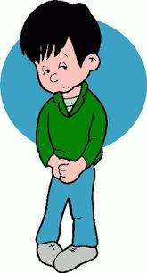
Concerning Changes in Student Behaviors
Tracking your students’ bassline behaviors and emotions and comparing them to what this student typically exhibits in the classroom will assist in noticing any escalation in risk factors and/or concerns.
Things to keep in mind:
Account for the fact that your students are navigating a “new normal” and may show signs of stress due to this current situation.
Your students are getting used to new video conferencing platforms and technology, so students may appear more shy or less likely to participate than when they are in the classroom. Their baseline behaviors could change as they become more comfortable with the technology and online routines.
Notes:
Tracking your students’ bassline behaviors and emotions and comparing them to what this student typically exhibits in the classroom will assist in noticing any escalation in risk factors and/or concerns.
HOWEVER, it is very important to remember that your student may make comments or show signs of stress one day but not the next. One abnormality in student behavior or comments is not a valid reason to open an investigation on a P/F/C, unless the behavior or comment leads you to suspect child abuse or neglect (then you are mandated to report the abuse to Children’s Protective Services and/or law enforcement). If you ever have any questions or concerns regarding a student’s behavior we recommend that you connect with another colleague who knows this student well. Other resource people are your school counselor(s) or nurse(s), administrator(s), and other trusted school staff who have a positive rapport with the student.
Here are a few things to keep in mind as your are tracking your students’ behaviors:
Account for the fact that your students are navigating a “new normal” and may show signs of stress due to this current situation.
Your students are getting used to new video conferencing platforms and technology, so students may appear more shy or less likely to participate than when they are in the classroom. Their baseline behaviors could change as they become more comfortable with the technology and online routines.

Slide 14


Concerning Changes in Student Behaviors
Note any sudden declines in performance, or swings in typical academic behavior
With online freedoms, some students are at an increased risk for commercial sexual exploitation. Pay attention to what students may share about new friends, new “job” or “new” plans they have for when the shelter in place ends.
Have a conversation with students about how they can safely convey any concerns – this could resemble the use of a safe word or phrase mutually agreed upon by the student and teacher.
Pay attention to written assignments and what a student may be revealing through their words or art.
Notes:
Here are a few other points to take note of as you monitor your students’ behaviors that could indicate signs of stress:
Note any sudden declines in performance, or swings in typical academic behavior.
With online freedoms, some students are at an increased risk for commercial sexual exploitation. Pay attention to what students may share about new friends, new “job” or “new” plans they have for when the shelter in place ends.
Have a conversation with students about how they can safely convey any concerns – this could resemble the use of a safe word or phrase mutually agreed upon by the student and teacher.
Pay attention to written assignments and what a student may be revealing through their words or art.
Commercial Sexual Exploitation requires a report to Children’s Protective Services.
It is important to note that a lack of turning in work alone is not a sign of child abuse or neglect.
Educators need to continuously examine their assignment policies and due dates to remove barriers for student participation.
For example, are all assignments due during the week with little time for completion over the weekends? Perhaps assigning due dates of Sunday evenings rather than Friday mornings will allow for P/F/C to assist their children with completing and submitting assignments on time.
A lack of turning in assignments is not a primary indicator of risk; however, it could be a warning sign when coupled with other indicators that we have discussed.

Slide 15

Using Instructional Strategies to Provide a Safe Space for Your Students
Use a variety of online platforms for students to check in with their peers and with you.
Host discussion boards and pose questions and/or assignments that may reveal how home life and social distancing is going.
If possible, create a safe mechanism for students to reach out for support if needed. This could involve a particular discussion board, use of email, or even a phone call.
Google and several text messaging apps provide alternative phone numbers that link to your personal phone number so that it is kept private. Calling the alternative phone number will connect your student to you directly. These services are typically free of charge.
Notes:
Educators can use instructional strategies to provide a safe space for your students.
Remember, distance learning is an uncharted territory for all of us and your students so creating routines and setting up safe spaces will help to reduce anxiety your students are feeling with the “newness” of their current educational settings.
Here are some suggestions to create safe spaces through instruction:
Use a variety of online platforms for students to check in with their peers and with you.
Host discussion boards and pose questions and/or assignments that may reveal how home life and social distancing is going.
If possible, create a safe mechanism for students to reach out for support if needed. This could involve a particular discussion board, use of email, or even a phone call.
Google and several text messaging apps provide alternative phone numbers that link to your personal phone number so that it is kept private. Calling the alternative phone number will connect your student to you directly. These services are typically free of charge.

Slide 16

Deepening Parent and Caregiver Interaction
It’s ok to simply be present and listen authentically.
Acknowledge tension between their work and family obligations.
Inquire about job loss and the family’s connections to other supports.
“What has helped you in the past?”
“What other adults are available to you right now?”
Reinforce parent’s need to care for self and create daily respite time.
Close with appreciation and gratitude.
Notes:
It’s ok to simply be present and listen authentically.
Acknowledge tension between their work and family obligations.
Inquire about job loss and the family’s connections to other supports.
“What has helped you in the past?”
“What other adults are available to you right now?”
Reinforce parent’s need to care for self and create daily respite time.
Close with appreciation and gratitude.
Remember- parents, families and caregivers need support right now as much as their students. Educators are in a special position right now to connect with your students families in ways that are not always possible in non-distance learning.

Slide 17

Responsibilities of Mandated Reporters
California Department of Social Services provides a web page with free training to meet California’s Mandated Reporter Training. The free training is available at: https://mandatedreporterca.com.
Chapter one of the 2019 Health Education Framework addresses requirements that teachers have as mandated reporters.
Child Abuse Identification & Reporting Guidelines provide information for school personnel to be able to identify signs of suspected child abuse or child neglect and to have the tools to know how to make a report.

Slide 18

Resources
Contacting their local non-profit Family Resource Center
Contacting the National Parent Helpline
(1-855-427-2736)

Slide 19

When the abuse occurs in the
Community
call:
Child Protective Services
209-558-3665 or
1-800-558-3665

Slide 20

The information in this power point is provided in conjunction with the Stanislaus County Community Services Agency in conjunction with:
Stephanie Gregson, Chief Deputy Superintendent of Public Instruction, CDE
Angela Ponivas, Bureau Chief, Office of Child Abuse Prevention, CDSS
Lea Darrah, Vice President of Education, CPTA
Nicole Brown, Secondary School Counselor, Elk Grove Unified School District, CTA
Lindsay Tornatore, Director, Student Achievement and Support Division, CDE

Slide 21



Questions & Answers
Notes:
Contact Stanislaus Community Services Agency at (209)558-3665

